Slide 1

Get Comfortable with Query tuning and Execution Plans
Patrick Flynn

Slide 2








Thanks to All Sponsors
Gold Sponsors
Silver Sponsor
Bronze Sponsor

Slide 3




Patrick Flynn SQL Server DBA Link Group
MCM – SQL Server 2008
MCSM – Data Platform
Production DBA for 10+ years.
https://github.com/sqllensman/Presentations
patrick@sqllensman.com
@sqllensman
Patrick Flynn

Slide 4
Execution plans
Agenda
Why should I care?
Where can I find them?
How do I read them?
What can they tell me?
Further Information

Slide 5
Execution plans
Agenda
Why should I care?
Where can I find them?
How do I read them?
What can they tell me?
Further Information

Slide 6
Execution plans … Why should I care?
Microsoft SQL Server – Transact-SQL (T-SQL)
Mixes set-based queries with procedural code
Multiple causes of slowness
Lots of procedural code
Typical fix: rewrite the procedural code as set-based code
SQL Server heavily optimized towards set-based code
Single query slow
Apparently the optimizer picked a slow algorithm
Execution plan shows what algorithms were chosen
And THAT is why we care!

Slide 7
Execution plans
Agenda
Why should I care?
Where can I find them?
How do I read them?
What can they tell me?
Further Information

Slide 8
Execution plans … Where can I find them?
Finding “problem plans” on a production server
Plan cache
Query Store
Extended events / trace
Monitoring tools
Various DMVs

Slide 9
Execution plans … Where can I find them?
Finding “problem plans” on a production server
Finding plan for a specific query
Estimated execution plan
Query optimizer compiles plan
Query NOT executed
Plan shown is how it will be executed
(With some exceptions)

Slide 10
Execution plans … Where can I find them?
Finding “problem plans” on a production server
Finding plan for a specific query
Estimated execution plan
Actual execution plan
Query optimizer compiles plan
Query IS executed, some run-time statistics added to plan
Plan shown is same as estimated plan
(Usually)
… but with those run-time statistics added

Slide 11
Execution plans … Where can I find them?
Finding “problem plans” on a production server
Finding plan for a specific query
Estimated execution plan
Actual execution plan
Live Query Statistics
Query optimizer compiles plan
Plan shown as execution starts
Run-time statistics continuously updated during execution
Numbers compared to estimates
Beware of effects of wrong estimates!
Mostly useful for long running queries

Slide 12

DEMOS
Notes:
SQL DB uses Public VMs hosting database engine
Managed Instance – Tenant Isolation via use of own dedicated VM’s that are injected into Customer VNet

Slide 13
Execution plans
Agenda
Why should I care?
Where can I find them?
How do I read them?
What can they tell me?
Further Information

Slide 14
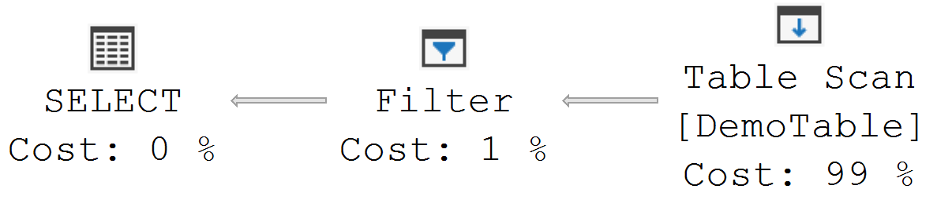
Execution plans … How to read them?
Elements within an execution plan
Icons (operators)
Small programs that “do something”
Arrows (data flows)
Not actual elements of the plan

Slide 15
Execution plans … How to read them?
Elements within an execution plan
Icons (operators)
Small programs that “do something”
Exactly three functions
Initialize()
Prepare to do work
Can also be used to reinitialize “restart from the top”
Some parameters can be changed when reinitialized

Slide 16
Execution plans … How to read them?
Elements within an execution plan
Icons (operators)
Small programs that “do something”
Exactly three functions
Initialize()
GetNext()
Return a single row to calling operator
How this row is produced depends on the specific operator
Often involves calling GetNext() on other operators

Slide 17
Execution plans … How to read them?
Elements within an execution plan
Icons (operators)
Small programs that “do something”
Exactly three functions
Initialize()
GetNext()
Close()
Clear up memory used etc
Called once per operator, when query has finished

Slide 18
Execution plans … How to read them?
Elements within an execution plan
Icons (operators)
Arrows (data flows)
Not actual elements of the plan
Represent which operators call which other operators
Each operator is called by, and returns rows to, exactly one operator
Calling operator is called the parent operator
Called operator is called the child operator

Slide 19
Execution plans … How to read them?
Elements within an execution plan
Icons (operators)
Arrows (data flows)
Not actual elements of the plan
Represent which operators call which other operators
Each operator is called by, and returns rows to, exactly one operator
Each operators calls zero, one, or more child operators
Execution plan is basically a “tree” (graph theory)
Hence operators within a plan are often called “nodes”

Slide 20
Execution plans … How to read them?
Common misunderstandings
Cost percentages
Looks deceptively easy … but often is just deceptive
Always based on estimated cost (even in actual execution plan!)
Incorrect if estimated row count is wrong
Can also be off for other reasons
E.g. hardware assumptions

Slide 21
Execution plans … How to read them?
Common misunderstandings
Cost percentages
Read direction
Left to right?
Right to left?
Something else?
GetNext()
?
GetNext()

?
GetNext()


Slide 22
Execution plans … They Suck?
https://bradsruminations.blogspot.com/2010/11/second-in-life-of-query-operator.html
http://blogs.lobsterpot.com.au/2012/12/30/the-sql-query-optimizer-when-logical-order-can-get-it-wrong/

Slide 23
DEMOS
Notes:
SQL DB uses Public VMs hosting database engine
Managed Instance – Tenant Isolation via use of own dedicated VM’s that are injected into Customer VNet

Slide 24
Execution plans
Agenda
Why should I care?
Where can I find them?
How do I read them?
What can they tell me?
Further Information

Slide 25
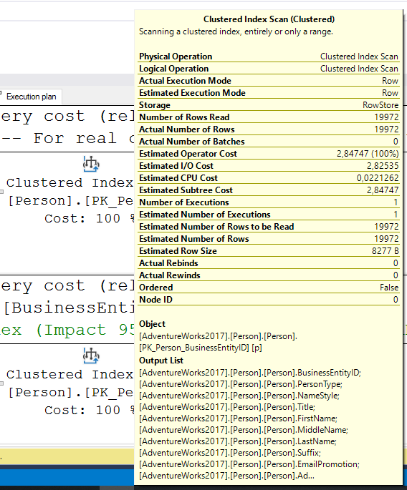
Execution plans … Properties
How to access properties?
Hover over an icon
Subset of properties for that operator
Chosen by Microsoft … not always best selection

Slide 26
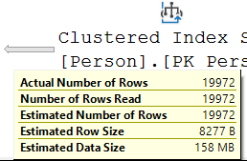
Execution plans … Properties
How to access properties?
Hover over an icon
Hover over an arrow
Even smaller subset of properties for operator to the right
Focuses only on amount of data produced by that operator

Slide 27
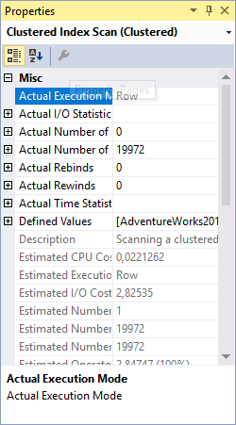
Execution plans … Properties
How to access properties?
Hover over an icon
Hover over an arrow
Right-click icon, select “Properties”
Properties window shows all properties
Bit harder to access
When you leave the properties window open, clicking on an operator in the plan changes the window to the operator you clicked
(This makes accessing the data less hard)

Slide 28
DEMOS
Notes:
SQL DB uses Public VMs hosting database engine
Managed Instance – Tenant Isolation via use of own dedicated VM’s that are injected into Customer VNet

Slide 29
Execution plans
Agenda
Why should I care?
Where can I find them?
How do I read them?
What can they tell me?
Further Information

Slide 30
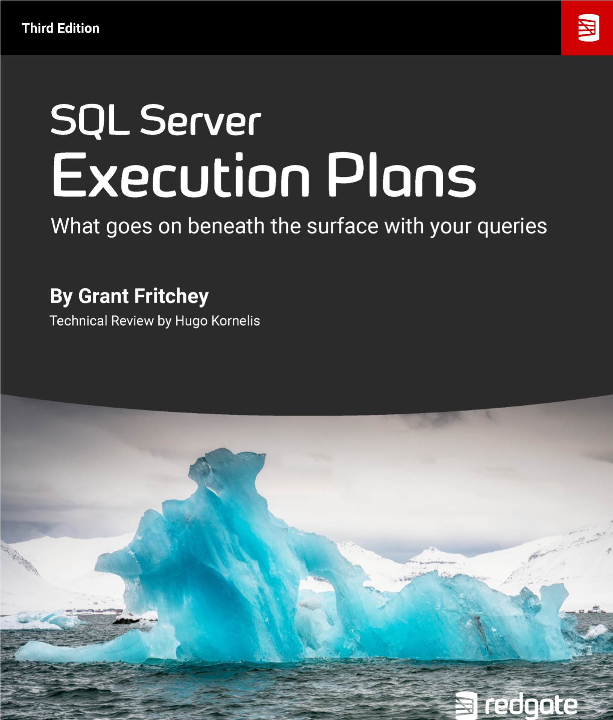
https://www.red-gate.com/products/dba/sql-monitor/entrypage/execution-plans

Slide 31
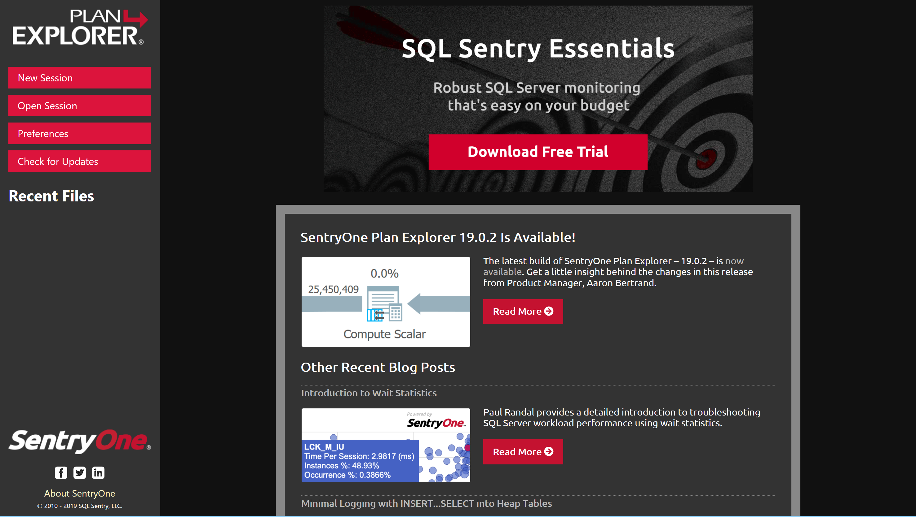

Slide 32
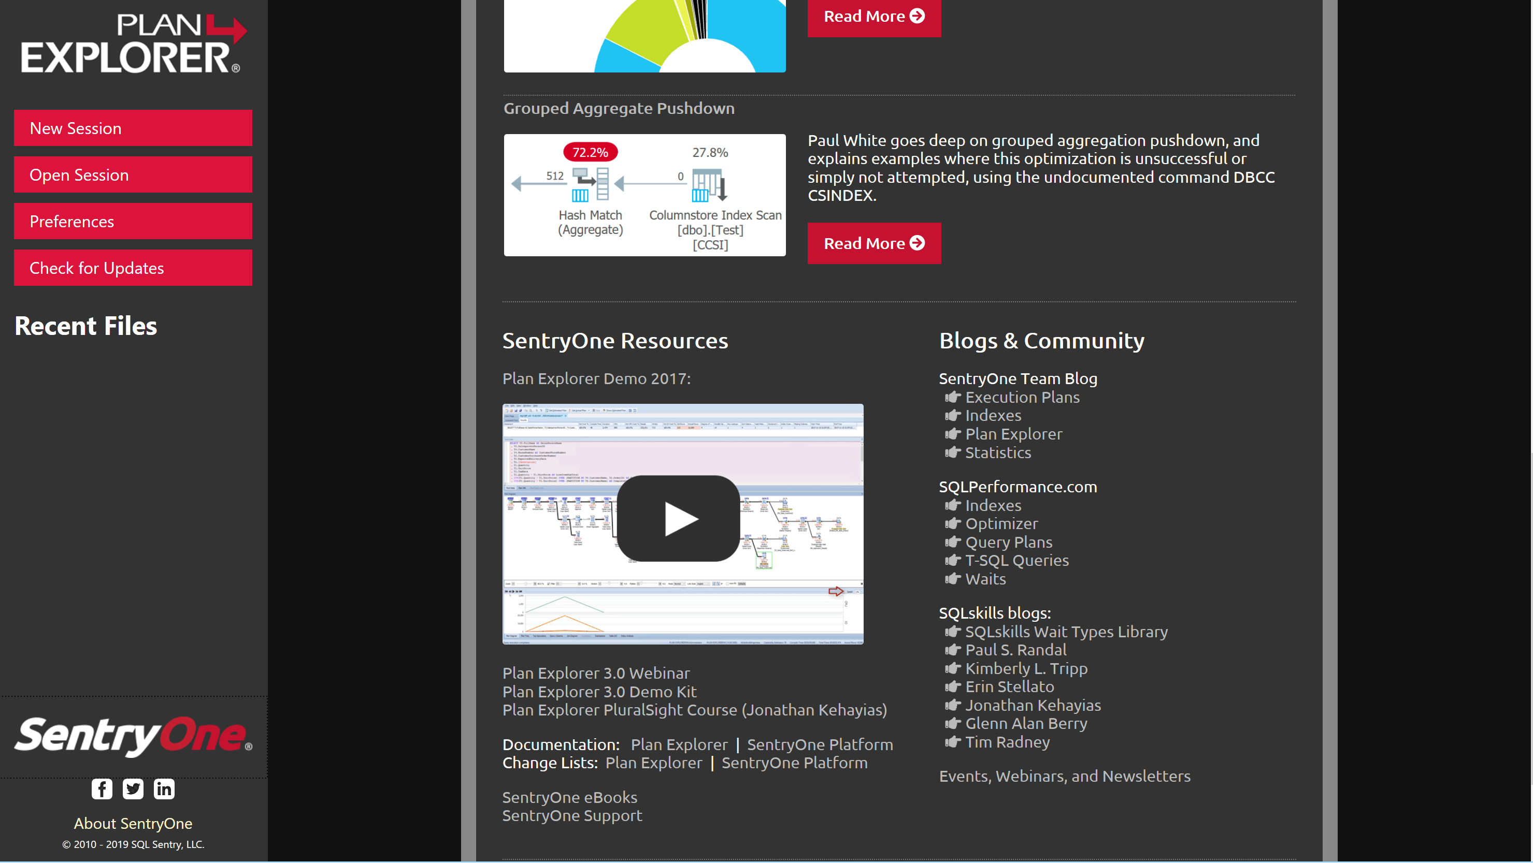

Slide 33
Resources for Plan Explorer
Download Page
https://sentryone.com/plan-explorer
Answers
https://answers.sqlperformance.com
User Guide
https://sentryone.com/help/PEug/
Support
https://support.sqlsentry.com/

Slide 34
Execution Plans
Execution Plan Reference: http://sqlserverfast.com/epr
Detailed description of all operators and other relevant information Commands

Slide 35
Other Blogs
Rob Farley:
https://sqlperformance.com/author/robfarley
http://blogs.lobsterpot.com.au/
Paul White
https://sqlperformance.com/author/paulwhitenzgmail-com
https://www.sql.kiwi/
Kevin Kline
https://www.sentryone.com/blog/kevinkline/sql-server-optimizer-trace-flag-86xx
Brad Hansen
https://www.tf3604.com/presentations/optimizer/

Slide 37


Slide 38


